Slide 1



ULTRA-GAIN BOOST CONVERTER FED BLDC MOTOR FOR FCEV APPLICATIONS
Presented by,
G. Vinay Kumar (20P65A0222)
B. Jhansi (19P61A0218)
B. Vinay Kumar (19P61A0217)
B. Sandeep (20P65A0205)
Under the guidance of,
Dr. B. Nagi Reddy _{M.Tech, PhD, MISRD} Associate Professor

Slide 2
Contents
Abstract
Introduction
Circuit Diagram
Design Equations
Operation
Simulink diagram
Results
Observation from results
Conclusions
Future scope
Publications
PO Attainment
References

Slide 3
Abstract
This project proposes Ultra-gain Boost converter-fed BLDC Motor for FCEV applications.
In the Ultra-gain boost converter, the output of the basic boost converter is fed as the input to the switched inductor circuit, this circuit raises the voltage level and provides a sufficient voltage at the output side.
The output voltage of the proposed converter is given to the BLDC Motor through an inverter for propulsion of the vehicle, this BLDC motor drives the wheels of a vehicle through the vehicle transmission system.
Project findings: The proposed Ultra-gain boost converter can obtain high voltage gain even with the small duty ratio values. By the proposed converter the speed of the BLDC motor can be controlled efficiently, which is suitable for EV applications. The use of BLDC motor reduces the overall cost, size, improves the performance and maintenance.

Slide 4
Introduction
In past, the majority of automakers used DC motors for electric vehicle applications. Adversely, DC motors have high maintenance cost and low efficiency due to the brushes and rotating devices.
At present, permanent magnet BLDC motor is mostly used in FCEV applications due to simple control, high reliability and high ruggedness.
An adequate motor considerably reduces the cost and size of the fuel cell.
The proposed Ultra-gain boost converter output voltage is given to the BLDC motor through an inverter for propulsion of the vehicle.
Ultra voltage gain boost converter supplies power to the BLDC motor.
The switches of the VSI are controlled by using electronic commutation of BLDC motor. The motor shaft is connected to vehicle wheels for the propulsion.

Slide 5
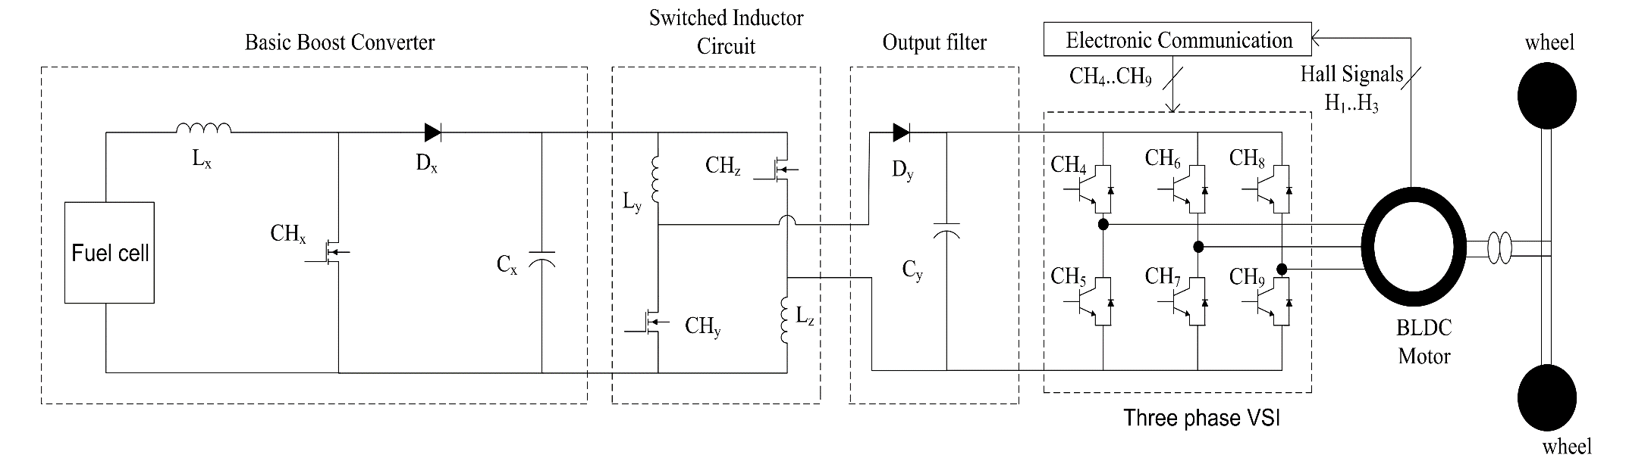
Circuit Diagram
Fig 1: Circuit diagram of proposed converter

Slide 6
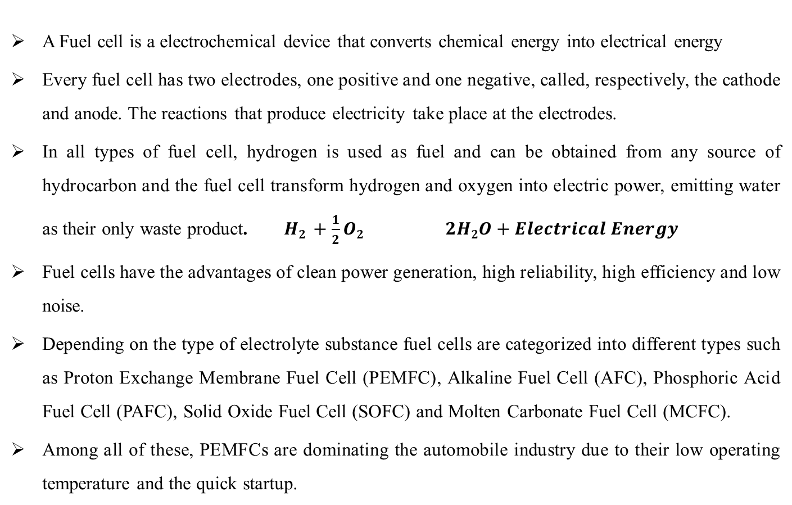
Fuel cell
A Fuel cell is a electrochemical device that converts chemical energy into electrical energy
Every fuel cell has two electrodes, one positive and one negative, called, respectively, the cathode and anode. The reactions that produce electricity take place at the electrodes.
In all types of fuel cell, hydrogen is used as fuel and can be obtained from any source of hydrocarbon and the fuel cell transform hydrogen and oxygen into electric power, emitting water as their only waste product.$H2 +\frac{1}{2}O2 2H2O+Electrical Energy$
Fuel cells have the advantages of clean power generation, high reliability, high efficiency and low noise.
Depending on the type of electrolyte substance fuel cells are categorized into different types such as Proton Exchange Membrane Fuel Cell (PEMFC), Alkaline Fuel Cell (AFC), Phosphoric Acid Fuel Cell (PAFC), Solid Oxide Fuel Cell (SOFC) and Molten Carbonate Fuel Cell (MCFC).
Among all of these, PEMFCs are dominating the automobile industry due to their low operating temperature and the quick startup.

Slide 7
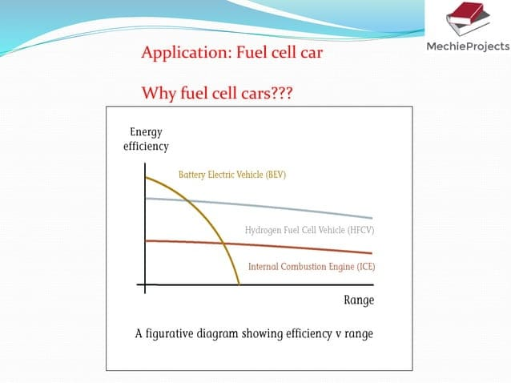
Efficiency Vs Range for various types of Vehicles:

Slide 8
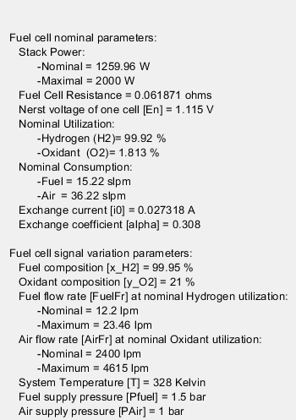
1.26 KW PEMFC (Fuel Cell) simulation Parameters

Slide 9
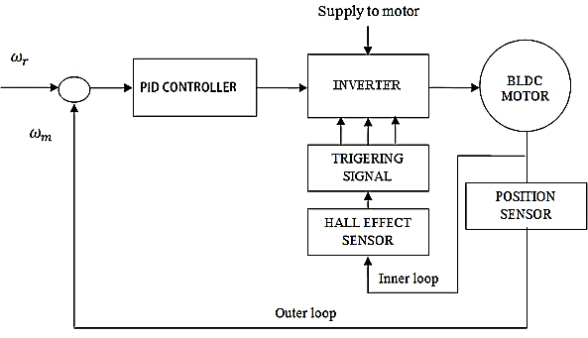
INVERTER FUNCTION:
The inverter is used for only dc-ac conversion and thereby energizing the stator coils in appropriate manner so that the BLDC motor will run smoothly.
The hall sensors is mounted on the motor which provides the hall signals which in turn is converted to EMFs for each phase and the switching of the inverter will be done accordingly.
SPEED CONTROL SYSTEM:
DC SUPPLY

Slide 10
A controller circuit is essential to operate and control the speed of a BLDC motor. There are many types of speed control system developed for controllers but the speed controllers have to modernize with the ages.
However, they are generally classified as closed loop and open loop control systems, respectively. Closed loop techniques are used for high accuracy control system.
In this case, the internal loop is used for tuning and sense the power supply polarity and the external loop is used to control the speed. The motor speed controller helps to adjust the voltage of the DC bus.
To control the system, DC supply is required and its value depends on the motor speed (rpm) and its capacity.
This system also requires a controller, in which case a PID controller is used that ultimately controls the inverter output voltage. A sensor is an integral part of a closed loop controller for controlling the speed of a motor.

Slide 11
BLDC MOTOR IN EV:
BLDC motor is normally powered by conventional three phase inverter which is controlled by the rotor position information obtained from Hall sensors or simply from hall position sensors.
In three phase windings, we use one Hall Sensor for each winding to provide three overlapping signals giving a 60° or 120° wide position range.
At present, permanent magnet BLDC motor is mostly used in FCEV applications due to simple control, high reliability and high ruggedness.
An adequate motor considerably reduces the cost and size of the fuel cell.

Slide 12
ADVANTAGES OF BLDC MOTOR IN EV:
With advancements in power electronics, A.C motor drives with IM or PMSM are much more preferred than a D.C drive with advantages of Reliability, Greater Efficiency, Less Maintenance and High Power Density.
PMSM offers overall reduction in the weight and volume for a given value of power. Owing to no rotor copper losses, the efficiency is much higher.
The reliability is quite high.
With advantages like elimination of the Brushes, ability to produce a larger Torque than the others at the same values of Current and Voltage, High Power Density and Great Efficiency, P.M Brushless D.C Motor Drive an ideal choice for being used in the Electric Vehicle Propulsion System.

Slide 13
Operation
Mode 1:
This mode is activated once the switches are turned on, the three switches are turned on simultaneously.
In this mode, inductor L_{X} is energized from the input dc-source, while inductors L_{Y} and L_{Z} are energized from capacitor C_{X}.
Diodes D_{X} and D_{Y} are reversely biased.
Output capacitor C_{Y} releases its energy to the load side.
The characteristic equations that describe this mode of operation are as follows:

Slide 14
Fig.2 Mode-1 configuration of proposed converter

Slide 15
Mode 2:
This mode is activated once the switches are turned off, the three switches are turned off at the same time.
In this mode, inductor L_{X} is discharging its energy into capacitor C_{X}, while inductors L_{Y} and L_{Z} are discharging their energy into output load and output capacitor C_{Y}.
In order to maintain a continuous path for the inductor currents, diodes D_{X} and D_{Y} work as freewheeling diodes when they are turned on.
The characteristic equations that describe this mode of operation are as follows:

Slide 16
Fig.3 Mode-2 configuration of proposed converter

Slide 17
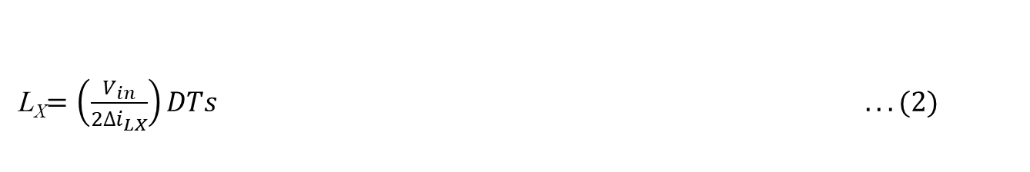
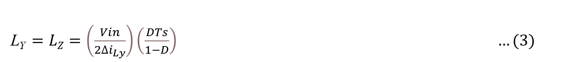
Design Analysis
Inductor Equations:
Inductor L_{x} Design
Inductor L_{y} and L_{z} Design:

Slide 18
Capacitor Equations:
Capacitor C_{X} design:
Capacitor C_{Y} Design:

Slide 19
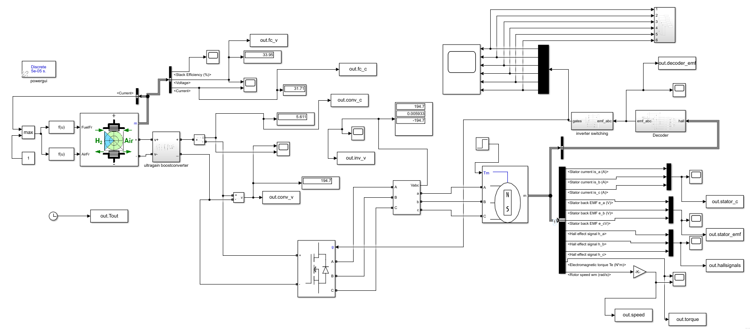
Simulink diagram
Fig 4: MATLAB Simulation Diagram of Whole System

Slide 20
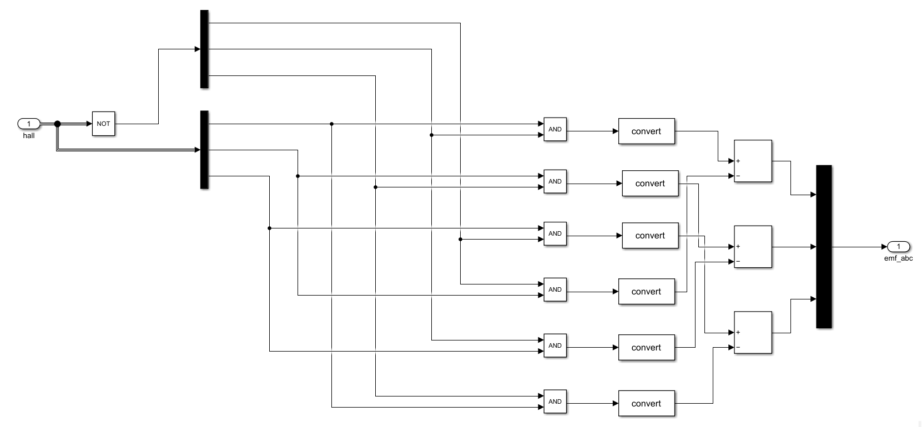
MATLAB Simulation of Decoder Block

Slide 21
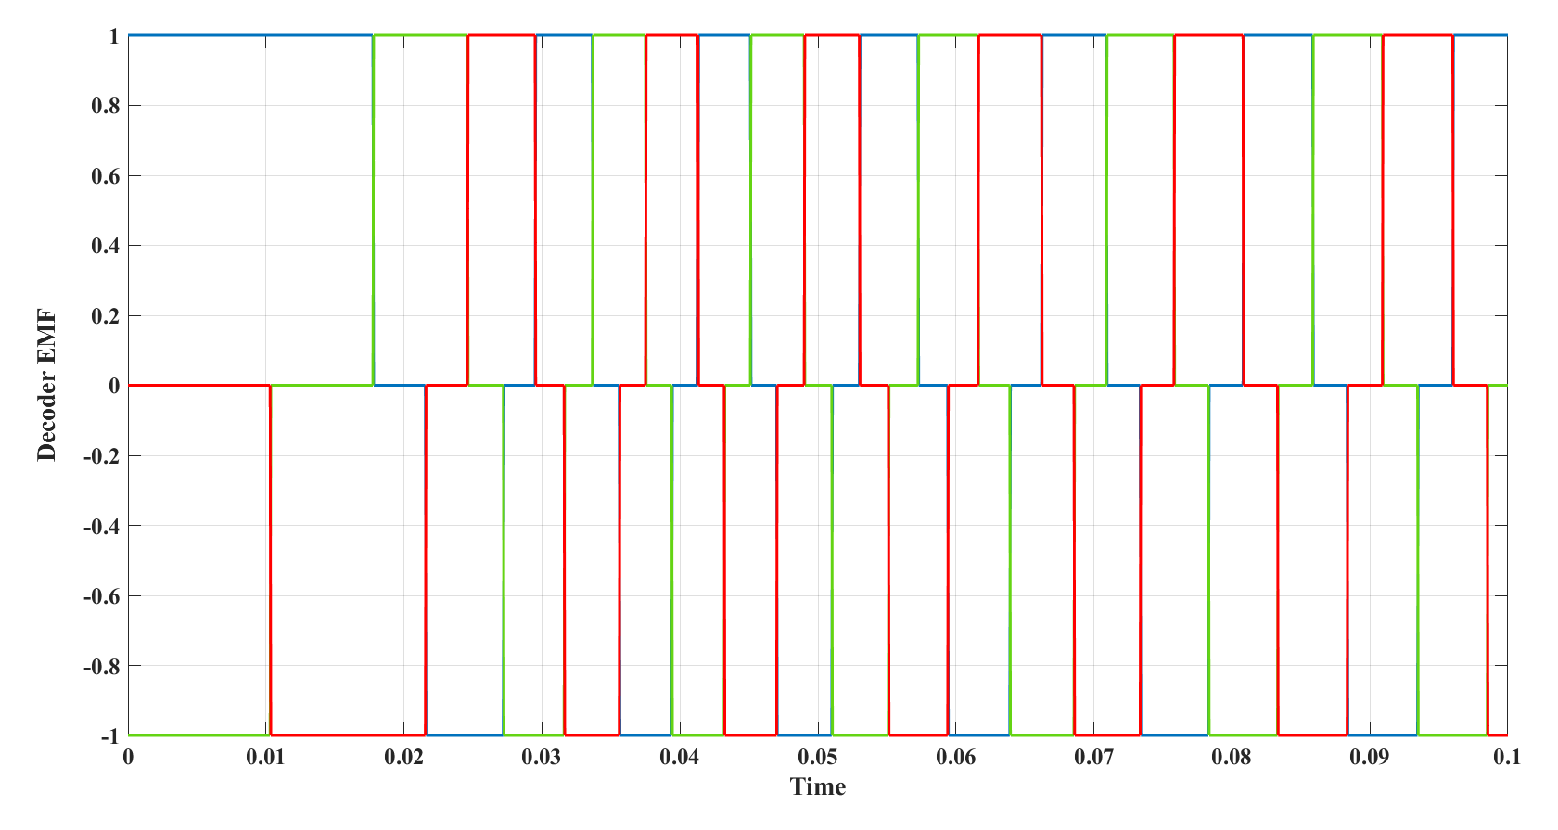
Decoder- EMF pulses of respective A,B & C Hall signals

Slide 22
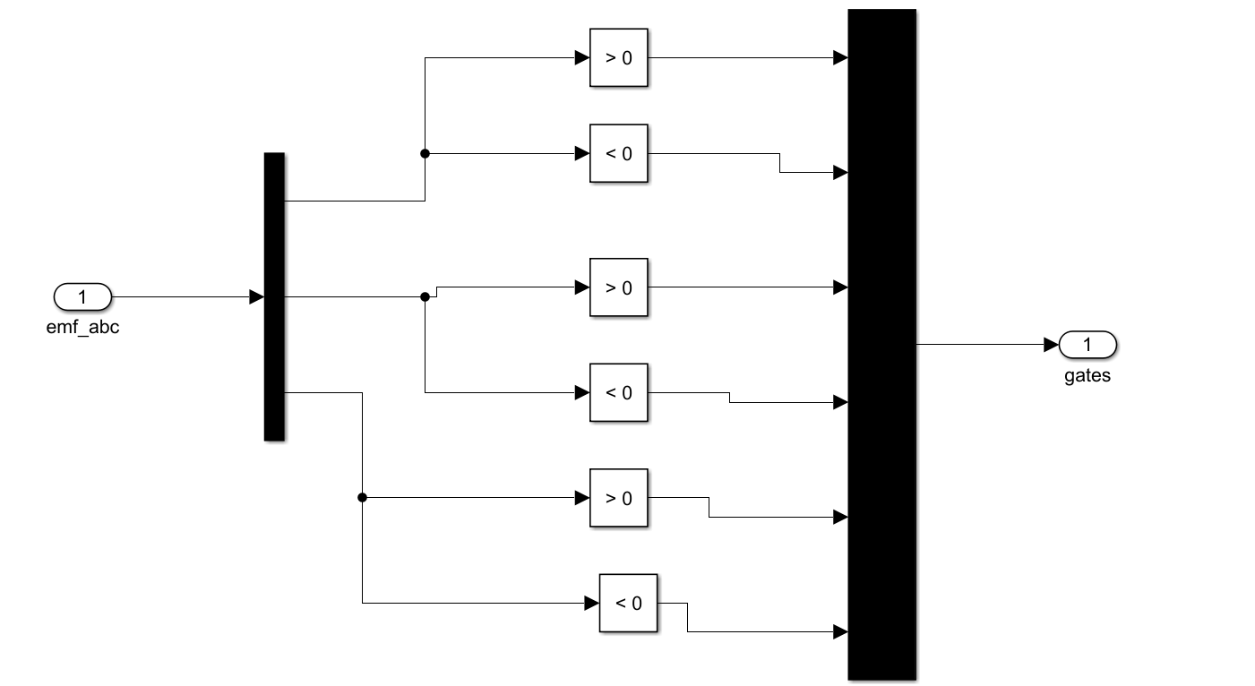
MATLAB Simulation of Inverter Switching Block

Slide 23
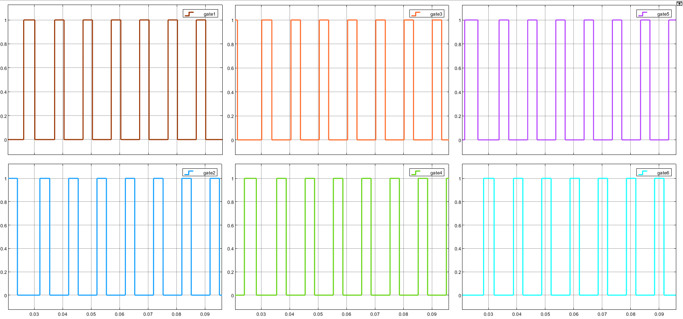
Gate Pulses Provided by Inverter- Switching Block
Gate Pulse
Time

Slide 24
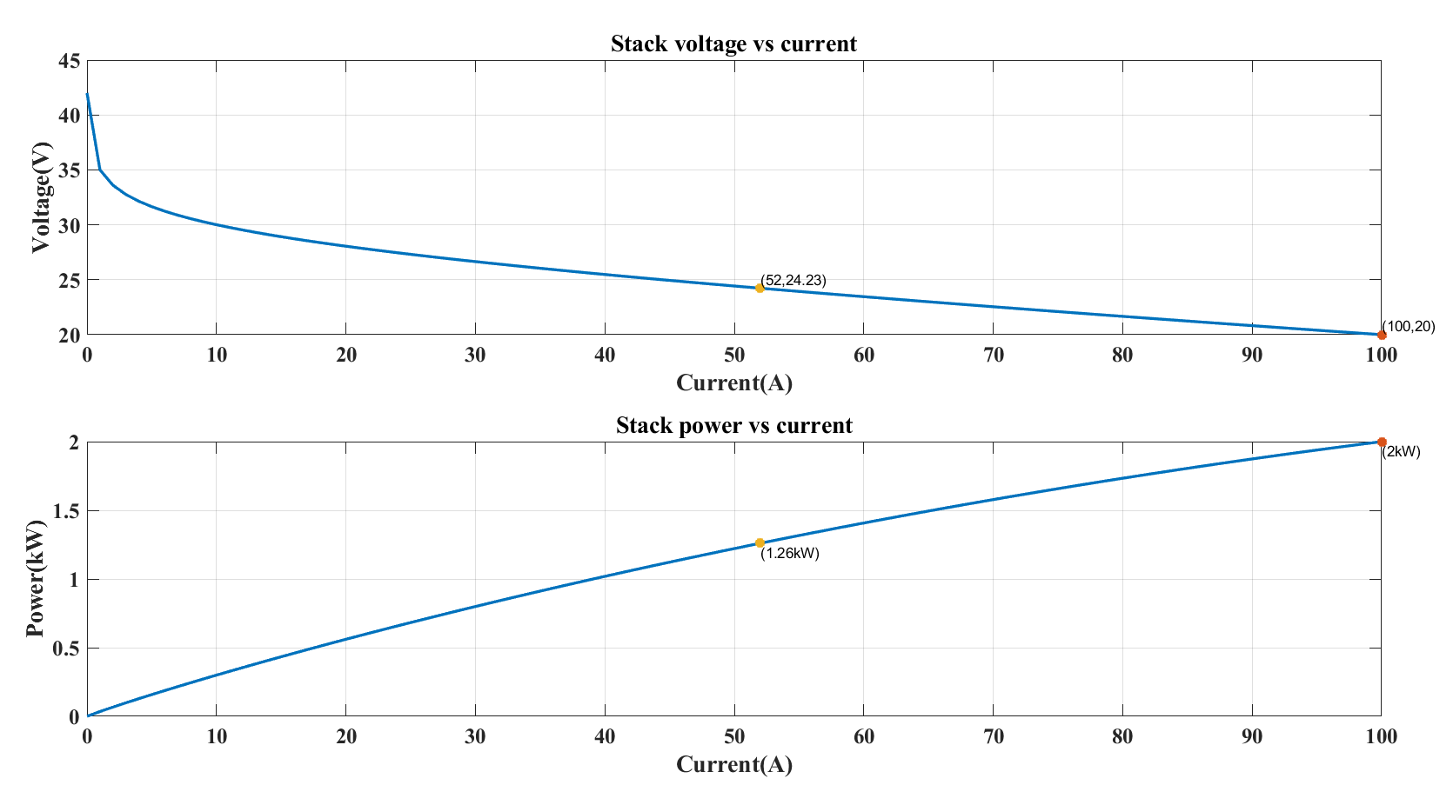
Results
V-I Characteristics of FUEL CELL

Slide 25
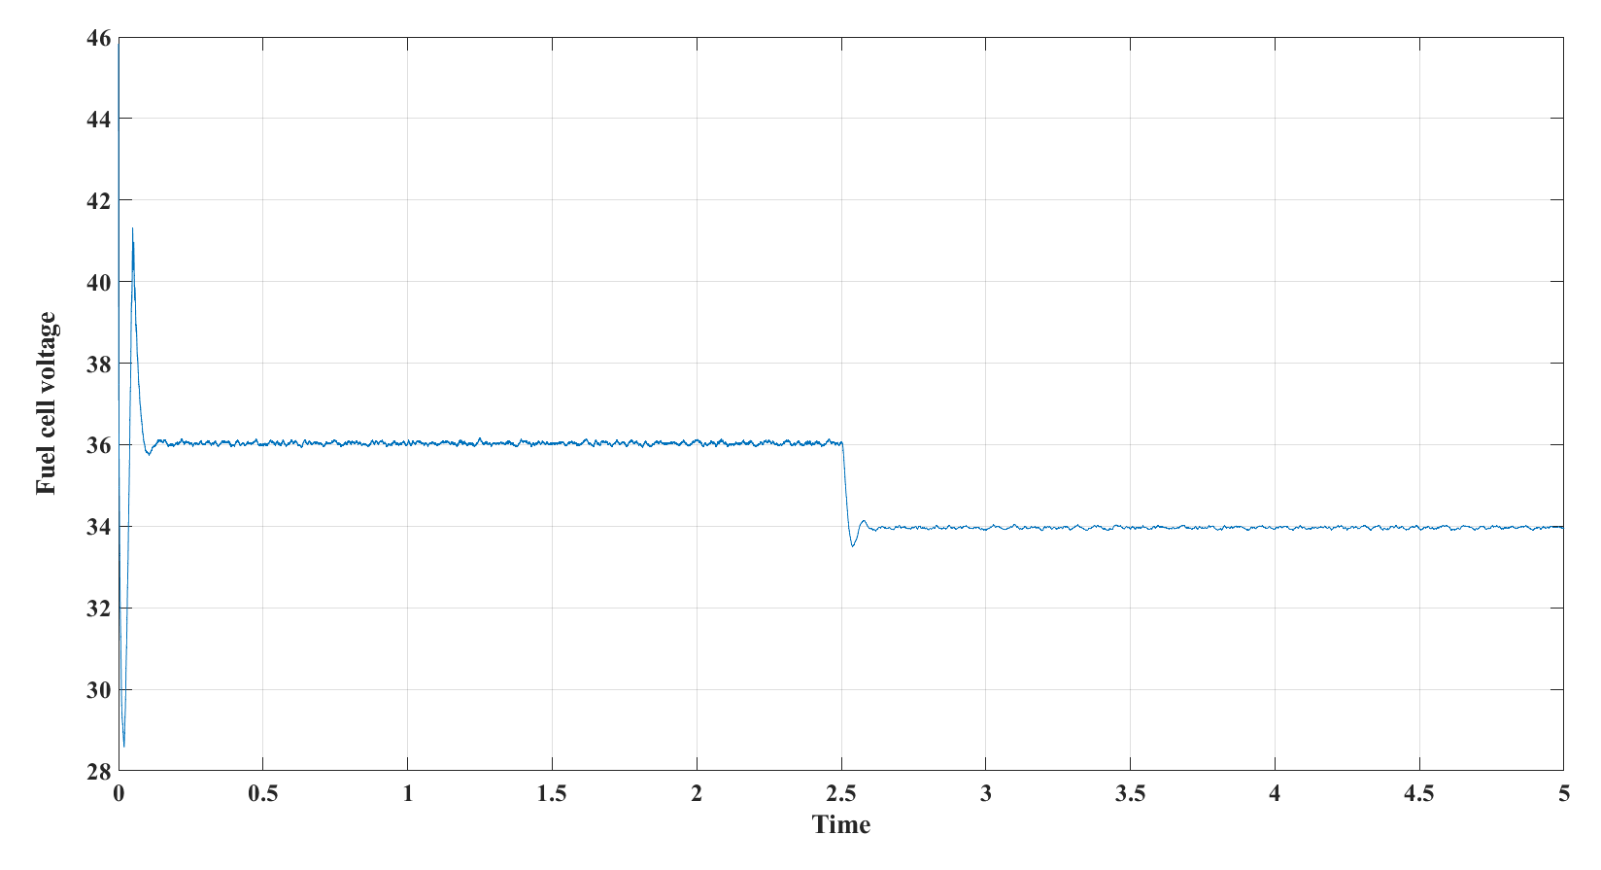
Output voltage of FUEL CELL

Slide 26
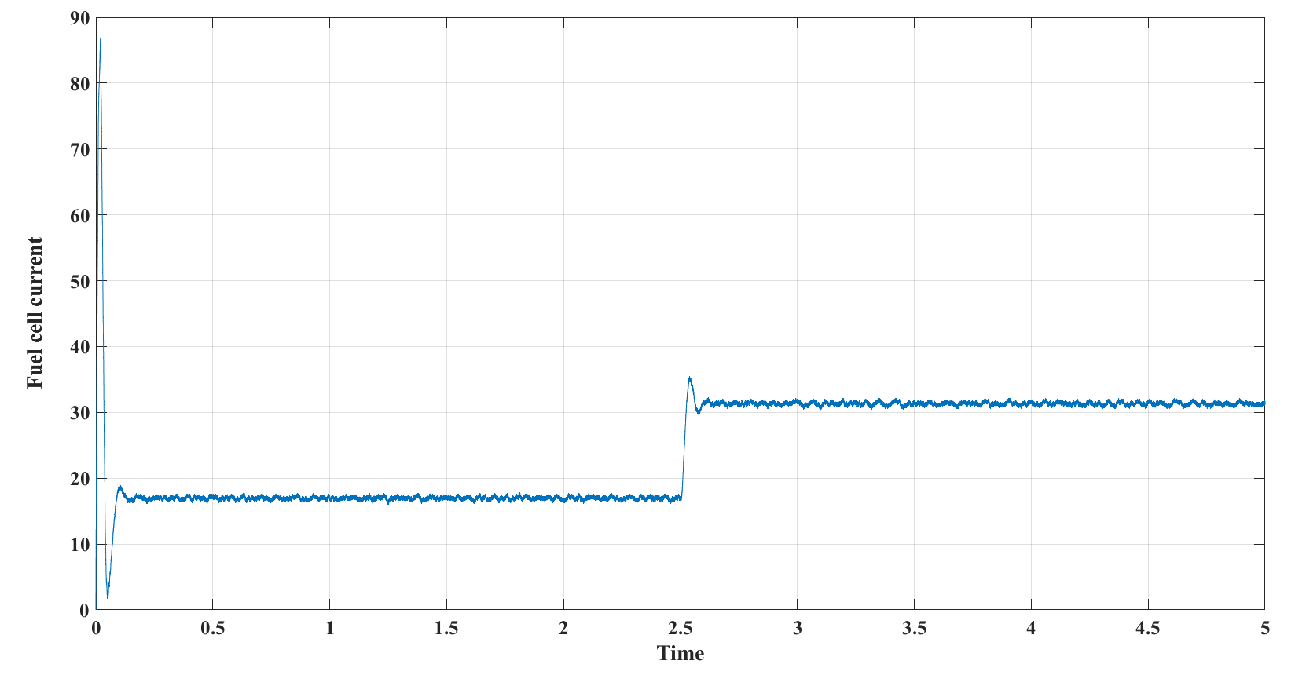
Output Current of FUEL CELL

Slide 27
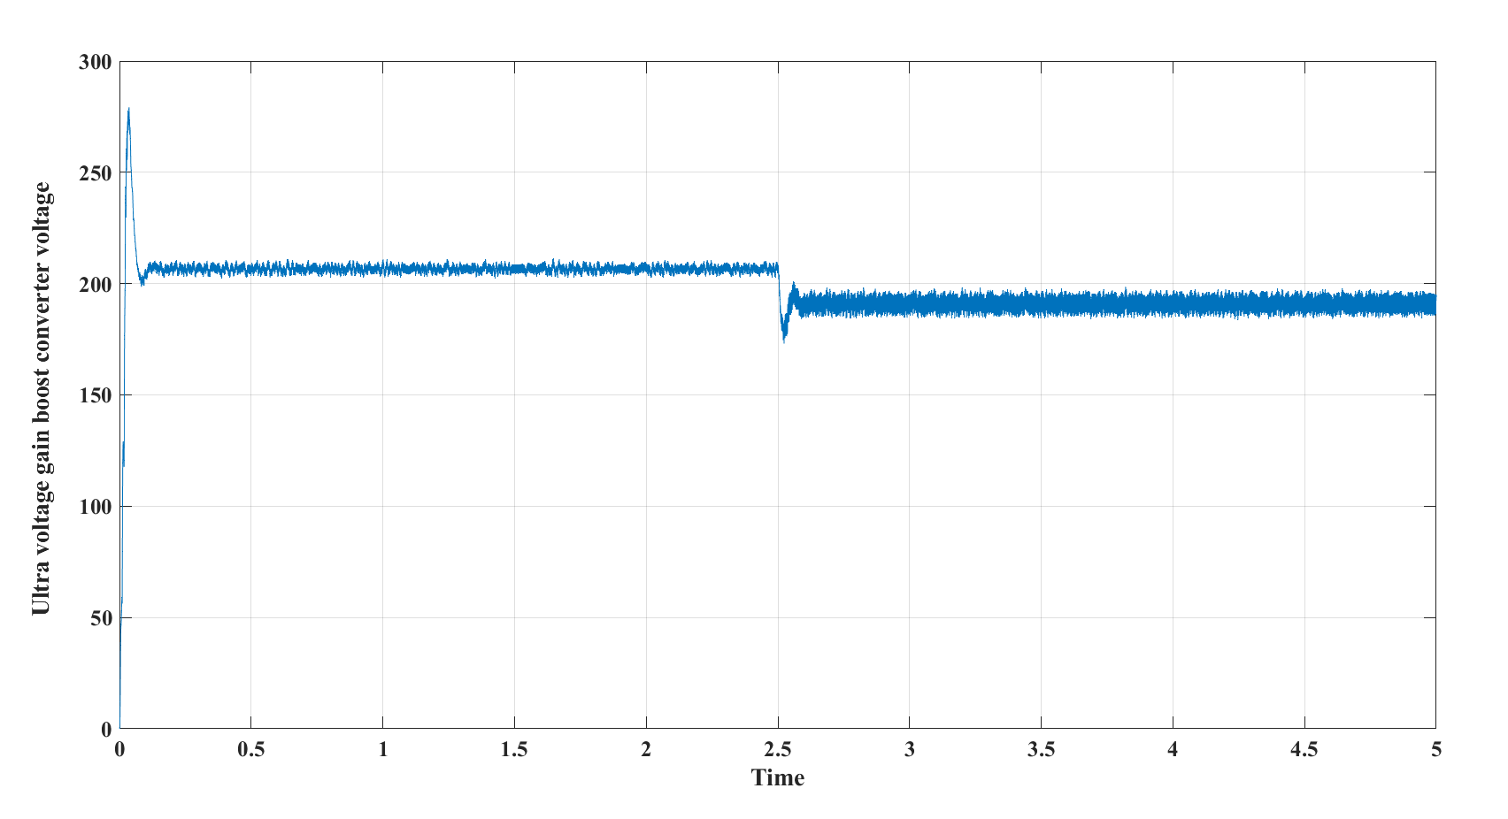
Output voltage of Ultra gain Boost converter

Slide 28
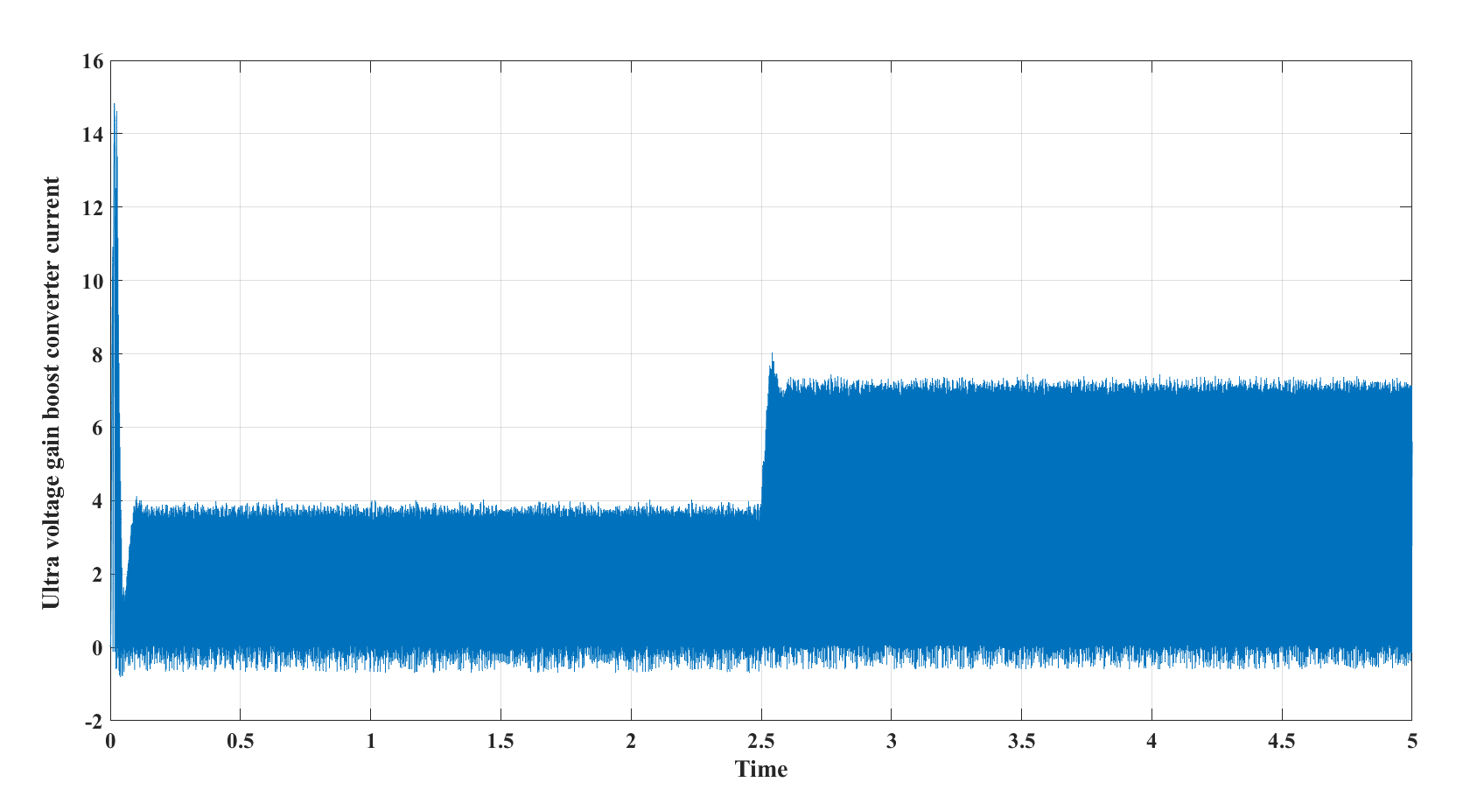
Output Current of Ultra gain Boost converter

Slide 29
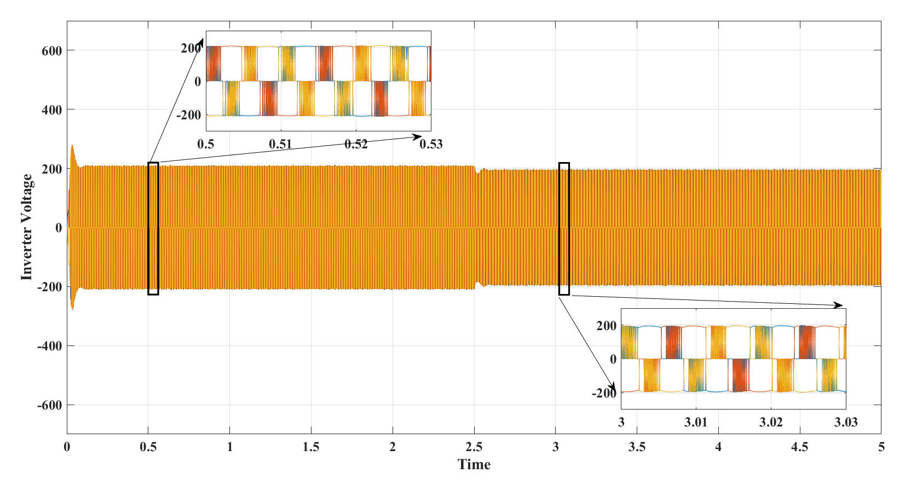
Inverter Output Voltages of A,B & C Phases

Slide 30
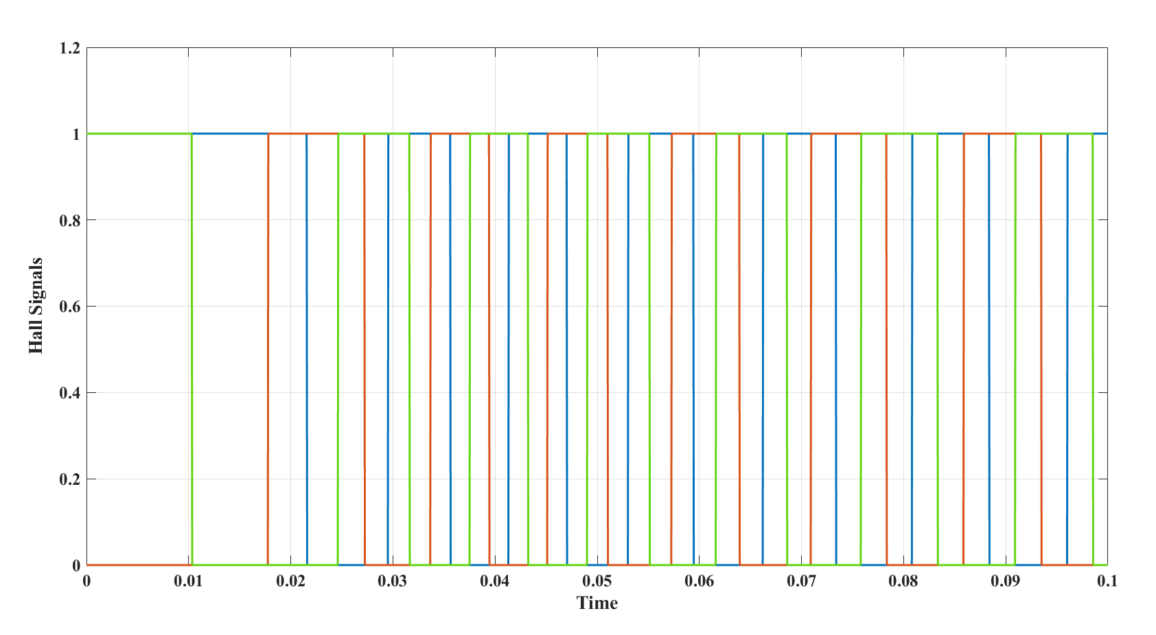
Hall Effect signal for phases A,B & C of BLDC Motor

Slide 31
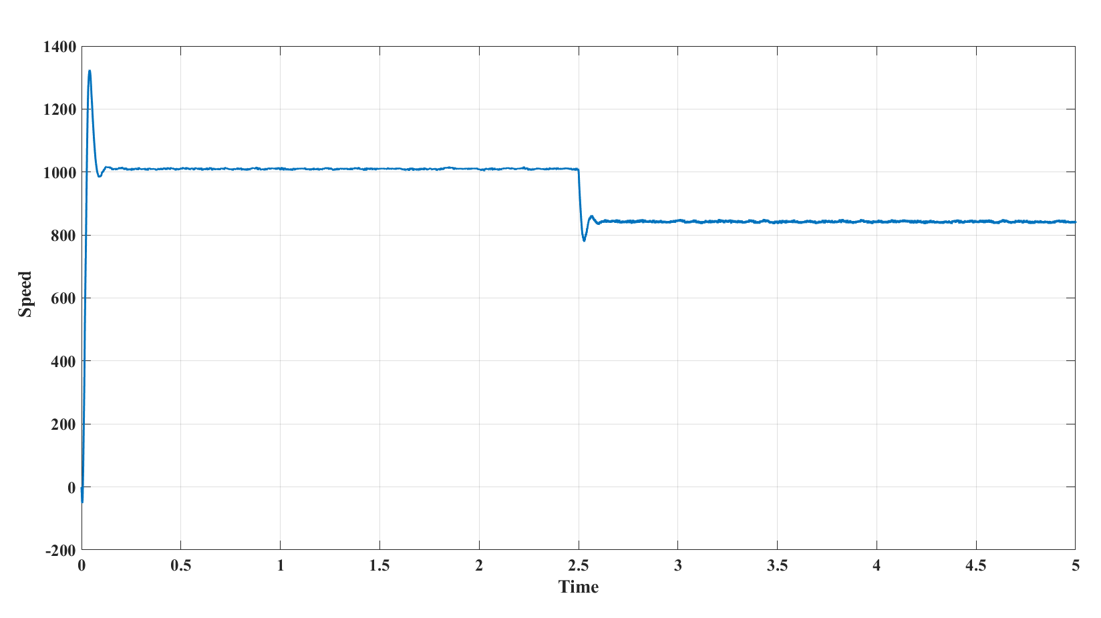
Speed of BLDC MOTOR

Slide 32
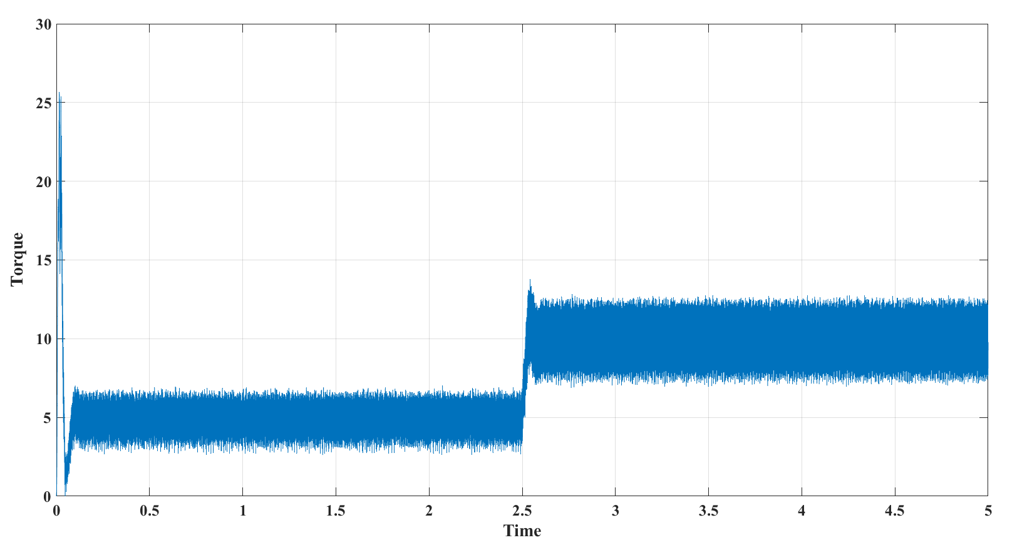
Electromagnetic Torque of BLDC

Slide 33
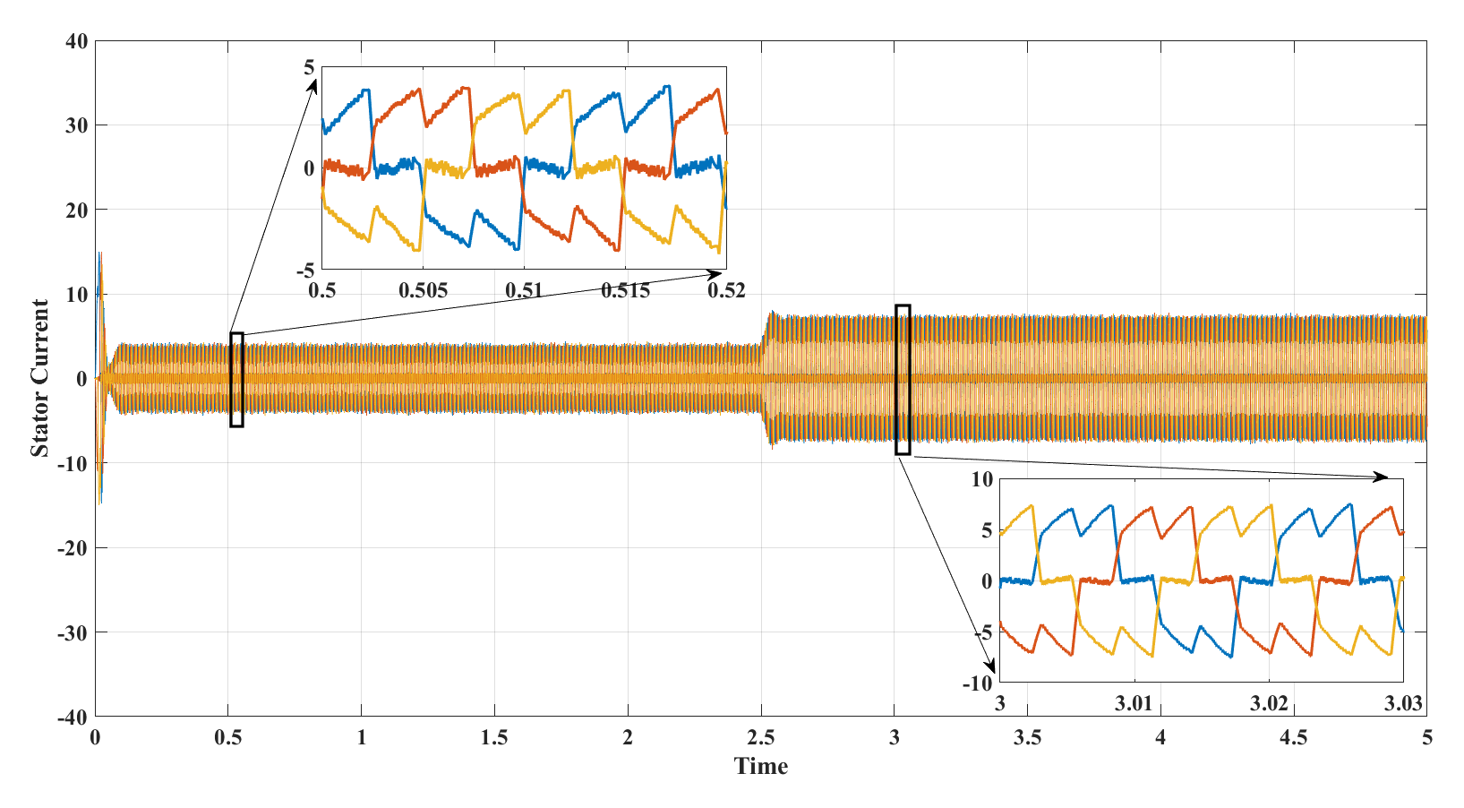
Stator Phase Currents of the BLDC Motor

Slide 34
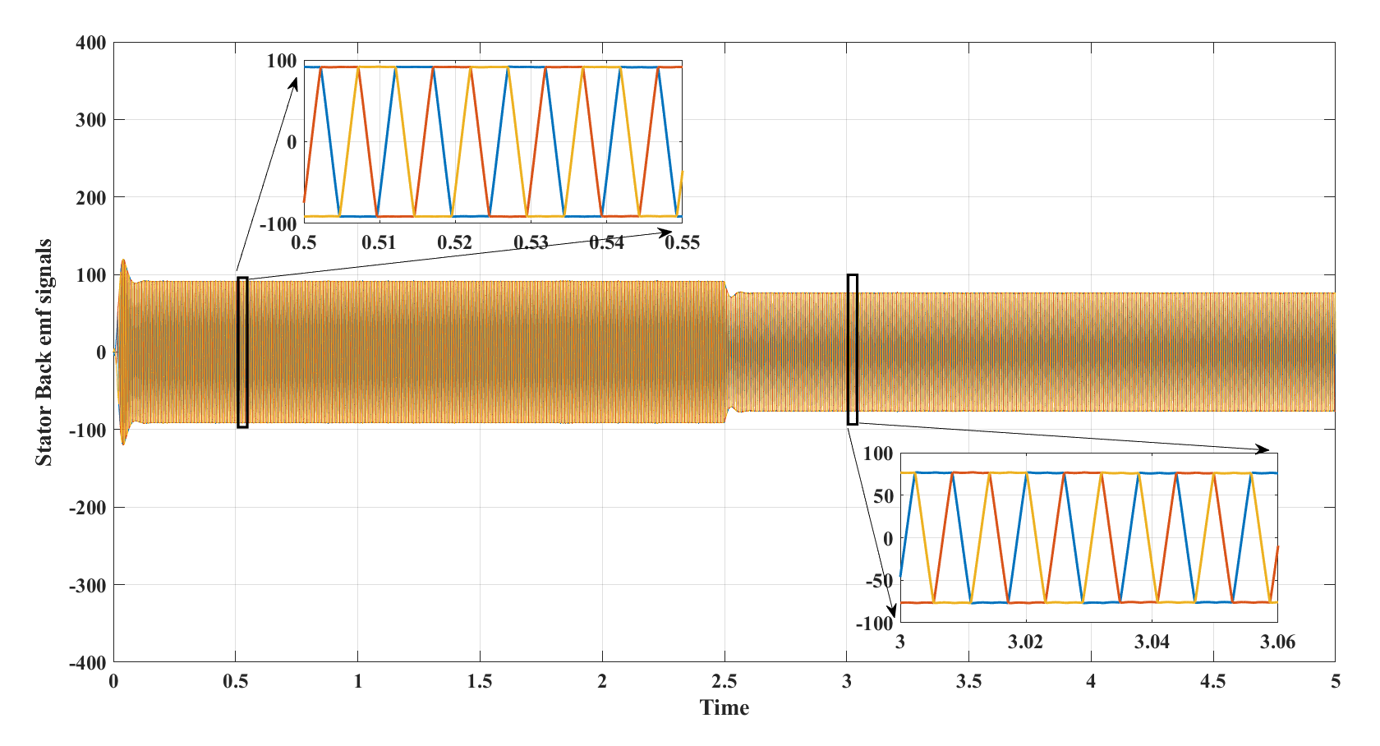
Trapezoidal Shaped Stator Back EMF signals of BLDC Motor

Slide 35
Observations from Results
The performance of the proposed converter in continuous current mode for steady state condition is analyzed.
From the simulation results, it can be observed that the proposed boost converter produces high voltage gain for small duty cycle.
The voltage and the current stresses of the proposed converter are lower when compared with the existing topologies.
Higher voltages with low ripple value is obtained. Minor Report
It can be observed that BLDC motor achieves better performance compared to Conventional DC motors in FCEV applications. But BLDC motor required complex electronic commutation.
It can be analyzed that Hydrogen fuel cell vehicles achieve better performance characteristics in regarding to Energy efficiency vs Range characteristics.

Slide 36
Conclusion
The proposed Ultra-gain boost converter fed to BLDC motor can obtain high voltage gain even with the small duty ratio values.
The proposed converter will reduce the fuel cell input current ripples and the voltage stress on the power switches.
A three-phase BLDC motor controller has been successfully designed and the performance of the proposed BLDC motor driven FCEV system is analyzed by using the MATLAB. The Simulation results obtained were consistent with the theoretical analysis.
A BLDC motor controller controls the motor's speed and torque, which is well suitable for Electric vehicle applications

Slide 37
Future scope
Fuel cells and their emerging technologies dominate the automobile industry in future due to their low operating temperature and the quick startup.
The rapid advancements in fuel cell technologies play a vital role in development of Advanced Electric vehicles in future.
In future BLDC motors can be well suited not only for FCEV vehicles but also for all types of Electric vehicles & for many other applications due to simple control, high reliability and high ruggedness etc.

Slide 38
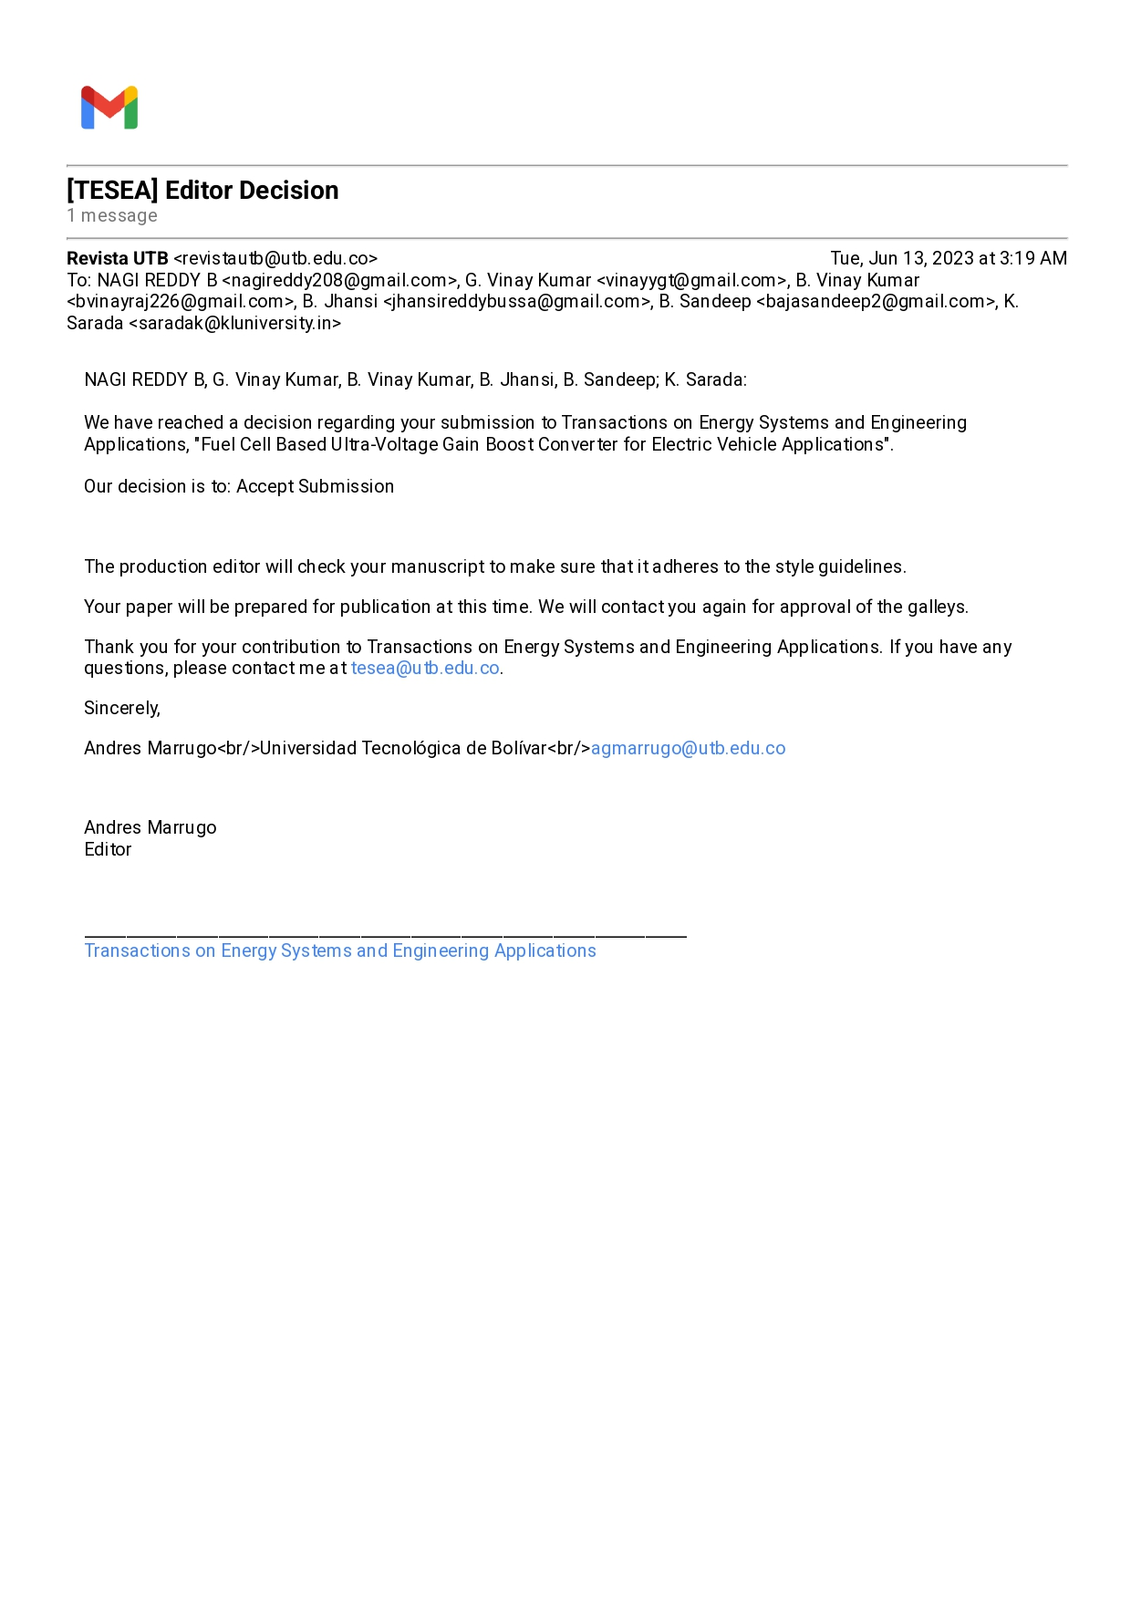
Publications
TITLE OF THE PROJECT: FUEL CELL BASED ULTRA VOLTAGE GAIN BOOST CONVERTER FOR ELECTRICAL VEHICLE APPLICATIONS
NAME OF THE JOURNAL: TRANSACTIONS ON ENERGY SYSTEMS AND ENGINEERING APPLICATIONS

Slide 39
PO Attainment
AFTER THE COMPLETION OF THE PROJECT, THE FOLLOWING POS AND PSOS ARE ATTAINED
PO1, PO2, PO3, PO4, PO5, PO7, PO8, PO9, PO10, PO12 PSO1, PSO2, PSO3, PSO4

Slide 40
References
[1] K Jyotheeswara reddy, N Sudhakar (2018). High Voltage Gain Interleaved Boost Converter With Neural Network Based MPPT Controller for Fuel Cell Based Electric Vehicle Applications. IEEE Transactions Electronic ISSN: 2169-3536.
[2] Ye, Y., & Eric Cheng, K. W. (2014). Quadratic boost converter with low buffer capacitor stress. IET Power Electronics, 7(5), 1162–1170.
[3] Shahin, A., Hinaje, M., Martin, J.-P., Pierfederici, S., Rael, S., & Davat, B. (2010). High Voltage Ratio DC–DC Converter for Fuel-Cell Applications. IEEE Transactions on Industrial Electronics, 57(12), 3944–3955.
[4] Tofoli, F. L., de Souza Oliveira, D., Torrico-Bascopé, R. P., & Alcazar, Y. J. A. (2012). Novel Nonisolated High-Voltage Gain DC–DC Converters Based on 3SSC and VMC. IEEE Transactions on Power Electronics, 27(9), 3897–3907.
[5] Bist, V., & Singh, B. (2014). An Adjustable-Speed PFC Bridgeless Buck–Boost ConverterFed BLDC Motor Drive. IEEE Transactions on Industrial Electronics, 61(6), 2665–2677.
[6] Singh, B., & Bist, V. (2015). A BL-CSC Converter-Fed BLDC Motor Drive With Power Factor Correction. IEEE Transactions on Industrial Electronics, 62(1), 172–183.

Slide 41
[7] Ardi, H., Ajami, A., Kardan, F., & Nikpour, S. (2016). Analysis and Implementation of a Non-Isolated Bidirectional DC-DC Converter with High Voltage Gain. IEEE Transactions on Industrial Electronics, 1–1.
[8] Kumar, J. S. V. S., & Rao, P. M. (2017). Design and simulation of front end converter for fuel cell based electric vehicle applications. 2017 IEEE International Conference on Power, Control, Signals and Instrumentation Engineering (ICPCSI). doi:10.1109/icpcsi.2017.8392338
[9] De Almeida, P. M., Valle, R. L., Barbosa, P. G., Montagner, V. F., Cuk, V., & Ribeiro, P. F. (2021). Robust Control of a Variable-Speed BLDC Motor Drive. IEEE Journal of Emerging and Selected Topics in Industrial Electronics, 2(1), 32–41. doi:10.1109/jestie.2020.3035055
[10] Li, W., Zhao, Y., Wu, J., & He, X. (2012). Interleaved High Step-Up Converter With Winding-Cross-Coupled Inductors and Voltage Multiplier Cells. IEEE Transactions on Power Electronics, 27(1), 133–143. doi:10.1109/tpel.2009.2028688
[11] Zhou, X., Chen, X., Peng, C., & Zhou, Y. (2018). High Performance Non-Salient Sensorless BLDC Motor Control Strategy from Standstill to High Speed. IEEE Transactions on Industrial Informatics, 1–1.

Slide 42
Queries

Slide 43

References
EPS/ PEED
THANK YOU

